Slide 1
MemComb Sprint 1
Bassam Thomas
Danny Naum
Chris Stidham
Scott O’Neil
Nathan Hyde
David Michon
Jacob Couveau

Slide 2
User authentication
Using Okta, we were able to create a simple login page along with
User Creation
Role Management
Locking/Unlocking accounts
Email verification
Notes:
Jacob

Slide 3
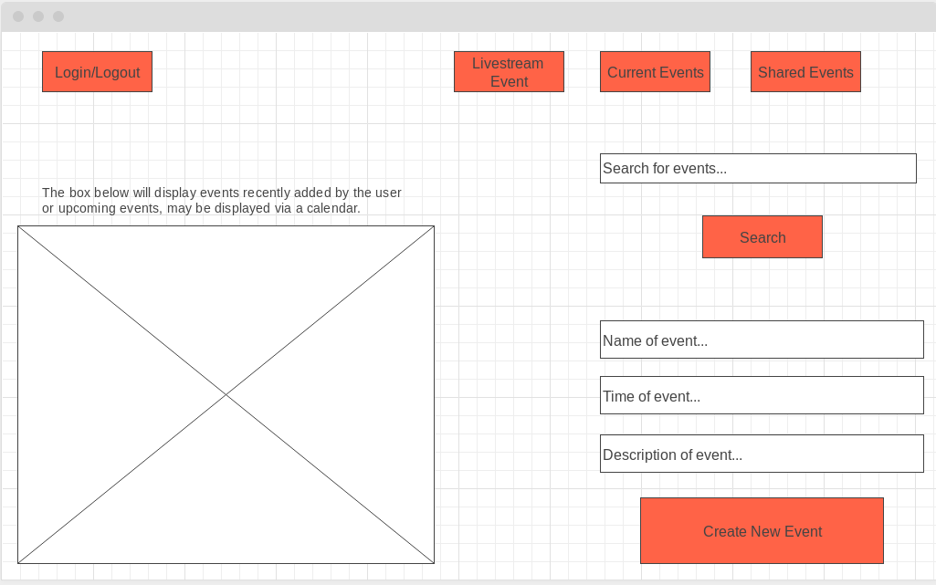
Rough Sketch of UI Design
Notes:
Nathan

Slide 4
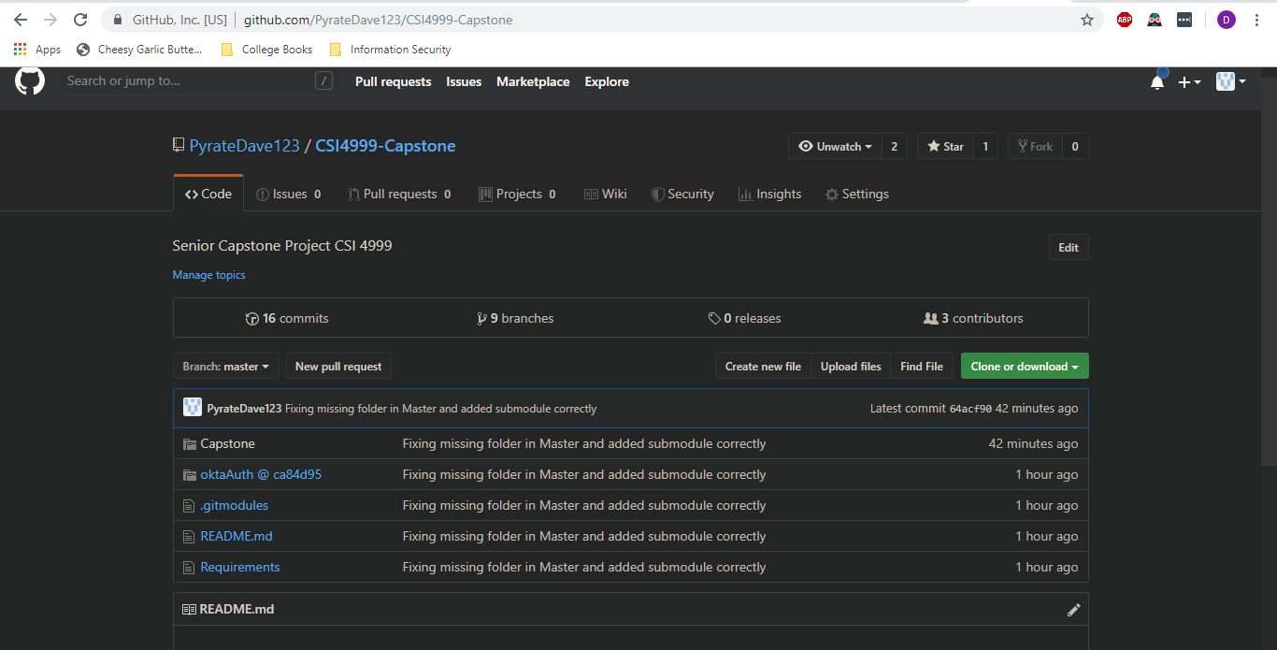
GitHub
Notes:
David

Slide 5

Creating an Account and Signing In
Notes:
David

Slide 6
Okta Authentication, User/Role Management
Notes:
David

Slide 7
Looking Forward
Our Next Sprint
Implement UI for Login Page
QA Testing for Authentication
Camera Integration Research
Beginning of Events Database
Notes:
David

